Slide 1



DS 7374
TRANSITIONRX:
MEDICATION COMPLEXITY & CARE-TRANSITION READMISSION RISK FOR DIABETES PATIENTS
Presented By :
Erika DuPond

Slide 2



BUSINESS PROBLEM AND STAKEHOLDER
Question:
Can medication count, the rate of patient-regimen-change, and quality of discharge education— flag which diabetes patients are at an elevated risk of a 30-day readmission?
Business Problem Background
Diabetes patients are frequently readmitted within 30 days, often because of how discharge is handled:
Too many medications, last-minute regimen changes, and weak handoff or education.
Roughly a fifth of readmissions are medication-related and arguably preventable.
One analysis found only 12–34% of discharge summaries reached the aftercare provider before first follow-up.
Most hospitals can't flag which patients combine a complex regimen with a thin transition.
Decision Supported
Which discharged diabetes patients get pharmacist-led medication reconciliation and a follow-up call, given limited staff time?
Stakeholder
Director of Pharmacy / Medication Safety with the Director of Care Management.
Notes:
Diabetes patients are one of the most readmitted groups in any hospital, and 30-day readmissions carry CMS penalties.
But pharmacy can only work up so many discharges a day. So the question isn't "who might come back" — it's "which patients get our limited pharmacist time?"

Slide 3




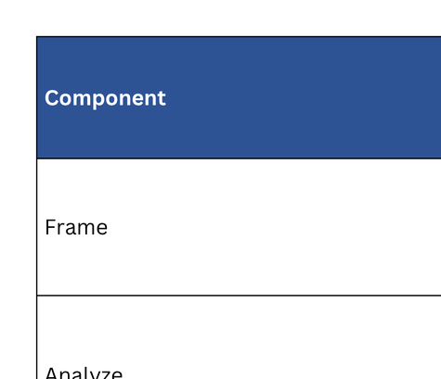
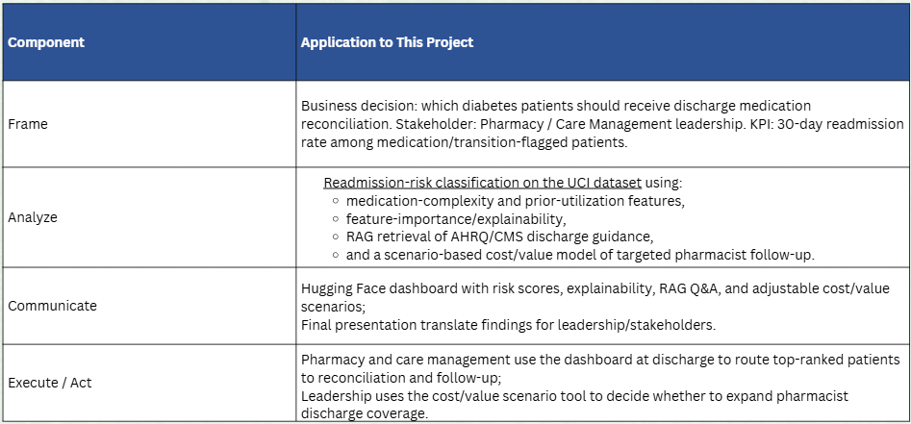
FACE FRAMING

Slide 4
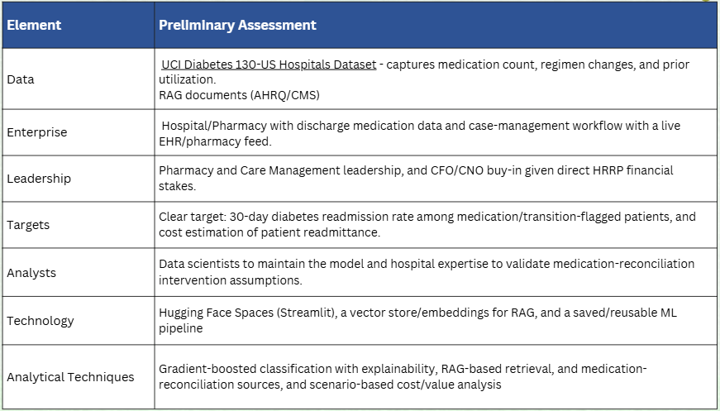
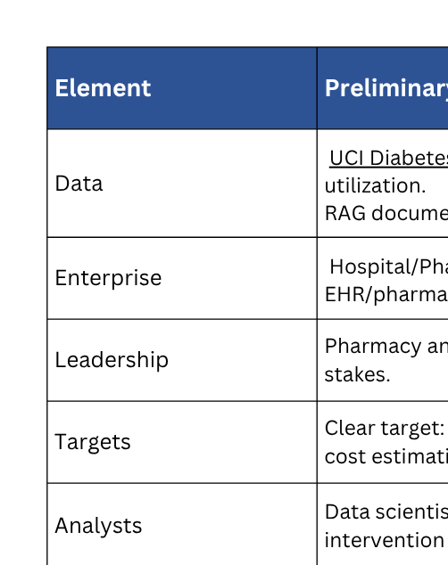
DELTA+ ASSESSMENT

Slide 5

DATA & METHODOLOGY
References
Agency for Healthcare Research and Quality. (2012). Medications at Transitions and Clinical Handoffs (MATCH) toolkit for medication reconciliation (AHRQ Publication No. 11(12)-0059). U.S. Department of Health and Human Services. https://www.ahrq.gov/patient-safety/settings/hospital/match/index.html
Agency for Healthcare Research and Quality. (2015). Re-Engineered Discharge (RED) toolkit (AHRQ Publication No. 12(13)-0084). U.S. Department of Health and Human Services. https://www.ahrq.gov/patient-safety/settings/hospital/red/toolkit/index.html
Agency for Healthcare Research and Quality. (2024). AHRQ health literacy universal precautions toolkit (3rd ed.). U.S. Department of Health and Human Services. https://www.ahrq.gov/health-literacy/improve/precautions/index.html
Centers for Medicare & Medicaid Services. (2026). Frequently Asked Questions For Publicly Reported Claims-Based Outcome Measures. https://qualitynet.cms.gov/files/69c59e5d4110de9e75d8df9e?filename=2026_CBM_FAQ.pdf
Centers for Medicare & Medicaid Services. (2026, July). Readmission Measures Hospital-Specific Report User Guide 2026 Public and Confidential Reporting. https://qualitynet.cms.gov/files/6a0dcffc0bc8b455c2401ecf?filename=July2026-Readmission-HUG.pdf
Discharge planning, 42 C.F.R. § 482.43 (2026). https://www.ecfr.gov/current/title-42/chapter-IV/subchapter-G/part-482/subpart-C/section-482.43
Strack, B., DeShazo, J. P., Gennings, C., Olmo, J. L., Ventura, S., Cios, K. J., & Clore, J. N. (2014). Impact of HbA1c measurement on hospital readmission rates: Analysis of 70,000 clinical database patient records. BioMed Research International, 2014, Article 781670. https://doi.org/10.1155/2014/781670
UCI Machine Learning Repository. (2014). Diabetes 130-US hospitals for years 1999–2008 [Data set]. University of California, Irvine. https://doi.org/10.24432/C5230J
Notes:
UCI Diabetes dataset — 130 hospitals, a hundred thousand encounters. But the raw file isn't the cohort, and three decisions here change the answer.
(point to the funnel)
We removed expired and hospice discharges — they can't be readmitted, so leaving them in makes the model look better than it is.
Then only the first encounter per patient — ninety-nine thousand down to seventy. Rows here are encounters, not patients, and repeats leak outcomes across the train/test split.
Target is readmission within 30 days, the CMS penalty window. 9% prevalence — a ten-to-one imbalance that drives every choice after this.
(gesture to the feature panel)
From there, 116 features — including a regimen-change score collapsing the 23 drug columns into how much a regimen was churned during the stay.

Slide 6
DATA & METHODOLOGY
UCI Diabetes 130-US Hospitals (1999–2008). Three cohort decisions materially change the result — each is a clinical judgment, not a default.
101,766
99,343
69,990
→
→
Raw encounters
Expired / hospice removed
First encounter per patient
1
Excluded expired & hospice discharges
116 ENGINEERED FEATURES
These patients cannot be readmitted — leaving them in dilutes the negative class with structural zeros.
Regimen-change / polypharmacy score from the 23 drug columns
Medication-count and prior-utilization bands
Age bands and ICD-9 comorbidity groupings
Care-transition proxies: discharge disposition, home without services
2
Kept first encounter per patient only
Rows are encounters, not patients. Repeat encounters leak outcome information across the train/test split.
3
Target = readmitted within 30 days
The HRRP penalty window. Prevalence 8.98% — a 10:1 imbalance that drives every later modeling choice.
Model: XGBoost, tuned via 4-fold randomized search on average precision · 55,992 train / 13,998 test · scale_pos_weight 10.14
Weight field dropped — 97% missing.
Notes:
> We used the UCI Diabetes dataset — a hundred and thirty US hospitals, about a hundred thousand encounters.
>
> But the raw file isn't the cohort. We made three decisions that materially change the answer, and I want to walk through them because this is where most readmission models quietly go wrong.
(point to the funnel)
> **First** — we removed expired and hospice discharges. About twenty-four hundred records. These patients **cannot be readmitted**. If you leave them in, they sit in the negative class as structural zeros and your model looks better than it actually is.
>
> **Second** — we kept only the first encounter per patient. This one's bigger: it took us from ninety-nine thousand rows down to **seventy thousand**. The rows in this dataset are encounters, not patients. If the same person appears three times, their outcome leaks across the train/test split and you get an inflated score that won't survive contact with real data.
>
> **Third** — our target is readmission within thirty days, because that's the CMS penalty window. That gives us a **9% prevalence** — roughly a ten-to-one class imbalance, which drives basically every modeling choice after this.
(gesture to the feature panel)
> From there we engineered a hundred and sixteen features. The one worth naming is the **regimen-change and polypharmacy score**, which collapses the twenty-three individual drug columns into how many diabetes agents a patient is on and how much their regimen was changed during the stay.
(optional, if you have time — this is a good line)
> One quick note on the footer: we dropped the weight field because it's **97% missing**.

Slide 7
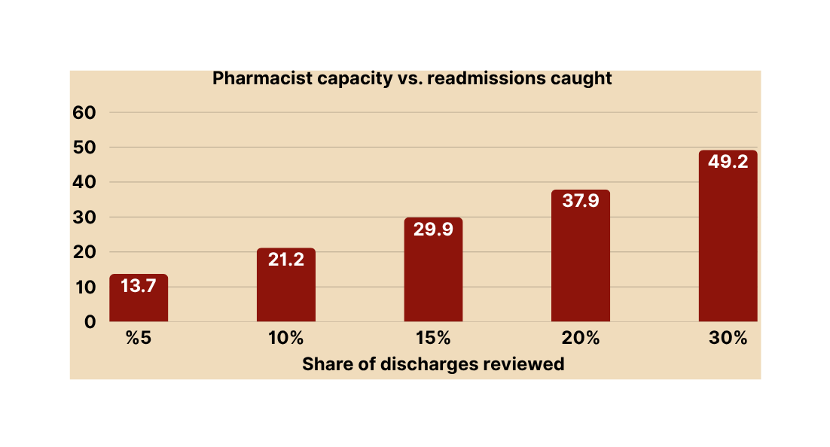
MODEL RESULTS — PERFORMANCE
Tuning gained little. That is the honest finding: mid-0.60s ROC-AUC is the ceiling for administrative billing data, and matches published work on this dataset.
0.655
0.166
38%
1.97×
ROC-AUC (tuned)
baseline 0.648
PR-AUC
vs. 0.090 base rate
Recall at operating
threshold 0.57
Precision lift over
base rate
CALIBRATION WAS REQUIRED
scale_pos_weight distorts probabilities upward. Isotonic calibration cut Brier score 0.222 → 0.079 while preserving AUC — necessary before any dollar figure can mean anything.
% of High-Risk Caught
THE THRESHOLD IS A BUSINESS DECISION
We set 0.57, not 0.5, to match reviewing the top 20% of discharges — a staffing constraint, not a statistical optimum.
Held-out test set: 13,998 encounters · 1,257 true 30-day readmissions · 477 caught at the operating threshold
Notes:
Bottom line first: this model is a modest predictor, and that's still useful.
Start with the fourth box — 1.97 times lift. Of every hundred patients we flag, about eighteen are readmitted within thirty days.
Base rate is nine percent. So we roughly double the hit rate. That's the practical value.
Recall is 38 percent — of everyone who actually came back, we caught thirty-eight percent of them ahead of time, at our cutoff.
(point to the first two boxes)
ROC-AUC is 0.655 — that's discrimination, and 0.5 would be a coin flip, so we're modestly above chance.
PR-AUC is 0.166 against a base rate of 0.090, which is the better metric on imbalanced data and again shows roughly double.
And I'll be direct: those are mediocre numbers. But this dataset is billing records — no vitals, no labs, no notes. Published work on this same data lands in the same range. We're not diagnosing anyone; we're ranking a worklist.
(point to the chart, then the bottom box)
Review the top twenty percent of discharges and you catch thirty-eight percent of readmissions. And note our cutoff is 0.57, not 0.5 — we set it to match capacity, not to optimize a statistic.

Slide 8
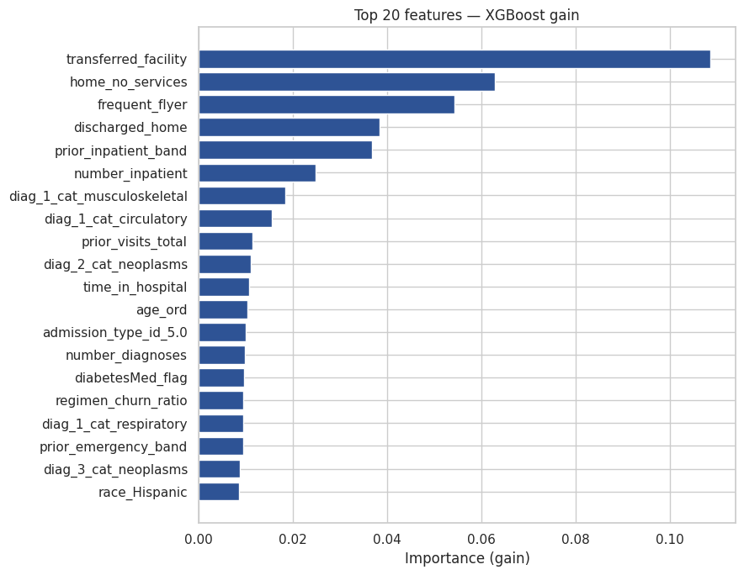
MODEL RESULTS — WHAT DRIVES RISK
Care-transition variables dominate the top of the ranking. Medication churn contributes, but it is not the headline driver — a finding that revises the original hypothesis.
WHAT THIS SAYS
Where a patient goes at discharge, and how often they have been admitted before, carry more signal than how many diabetes drugs they are on. The transition itself is the risk.
SHAP explanations give each flagged patient a plain-language reason — high medication count, multiple regimen changes, prior ED visits.
Gain-based importance on the tuned model; SHAP used for per-patient explanation in the deployed dashboard.
Notes:
What's the model keying on? Here I have to report something that revised our own hypothesis.
We expected medication complexity to lead. That was our proposal.
(point to the chart)
That's not what came out. The top six are almost entirely care-transition variables — where the patient goes at discharge, whether they went home with no services, how often they've been admitted before.
Medication churn didn't crack the top six.
So the transition carries more signal than the medication list. We're reporting it as found — and it's the more actionable finding, since discharge disposition and follow-up are things a care team directly controls.
(point to the SHAP line)
And SHAP gives every flag a plain-language reason. A pharmacist sees why, not just a score.

Slide 9
SECTION 04
WHY THIS PATIENT WAS FLAGGED
A score alone is not actionable. SHAP decomposes every prediction into the specific factors that drove it — so a pharmacist sees the reasoning, not just a number.
WHAT DROVE THE SCORE
PATIENT 04471
0.82
3 prior inpatient admissions this year
+0.53
Transferred to another facility, not home
+0.31
readmission risk score
Repeat-admission band: high
+0.17
FLAGGED
threshold 0.57
cohort average 0.09
Discharged to a facility rather than home
+0.15
9× the average patient's risk
4 total prior encounters
+0.09
Each bar is that factor's contribution to the risk score. Longer = more influence. Every prediction decomposes this way.
WHY THIS MATTERS TO THE PHARMACIST
This is not a generic high-risk patient — it is a repeat admitter being handed off to another facility. That points to a specific action: verify the medication list transfers with them.
Notes:
Use this slide to make the abstract concrete. The point is that two patients can share a 0.82 score for completely different reasons, and the reason determines the intervention. Note the honest caveat in the footer - SHAP values are additive in log-odds space, not probability space.
4

Slide 10
RAG COMPONENT
Retrieval over curated CMS and AHRQ guidance. The model says who is high risk; this says what to do about it — with citations.
6 source documents
1,408 chunks
900 chars / 150 overlap
MiniLM embeddings
384-dim, normalized
FAISS retrieval
+ similarity floor
Cited answer
citations verified
→
→
→
→
DOCUMENT CORPUS
AHRQ MATCH Toolkit — medication reconciliation at transitions
AHRQ Re-Engineered Discharge (RED) Toolkit
42 CFR § 482.43 — CMS discharge-planning Condition of Participation
AHRQ Health Literacy Universal Precautions Toolkit
CMS readmission measure and CBM guidance
0.60
0.50
Retrieval Hit@3
on gold question set
Mean groundedness
of generated answers
THREE GROUNDING GUARDRAILS
Similarity floor rejects off-topic questions · prompt requires citation or refusal · every [n] verified against retrieved passages · no drug or dose recommendations.
TWO STAKEHOLDER-FACING FUNCTIONS
Guidance Q&A — what CMS/AHRQ recommend for discharge planning.
Patient Action Brief — converts a flagged patient's SHAP drivers into a retrieval query and returns cited follow-up steps.
Not a general chatbot: the patient-brief function takes a flagged patient's SHAP drivers as input and cannot run without the model's output.
Notes:
The model tells you who. It doesn't tell you what to do. That's the RAG component.
Six curated documents — AHRQ's toolkits, the CMS regulation, health literacy guidance. Fourteen hundred chunks, MiniLM embeddings, FAISS retrieval, cited answers.
The evaluation numbers are modest and I'll say so — Hit-at-3 of 0.60, groundedness around 0.50.
(point to the guardrails box)
What matters more is the guardrails. A similarity floor refuses off-topic questions. The prompt requires a citation or a refusal. Every citation is verified after generation. And we forbid dosing recommendations outright — an LLM reading billing data shouldn't be near that decision.
(point to the two-functions box)
And what makes it not a chatbot: the Patient Action Brief takes a flagged patient's SHAP drivers as input. It can't run without the model.

Slide 11
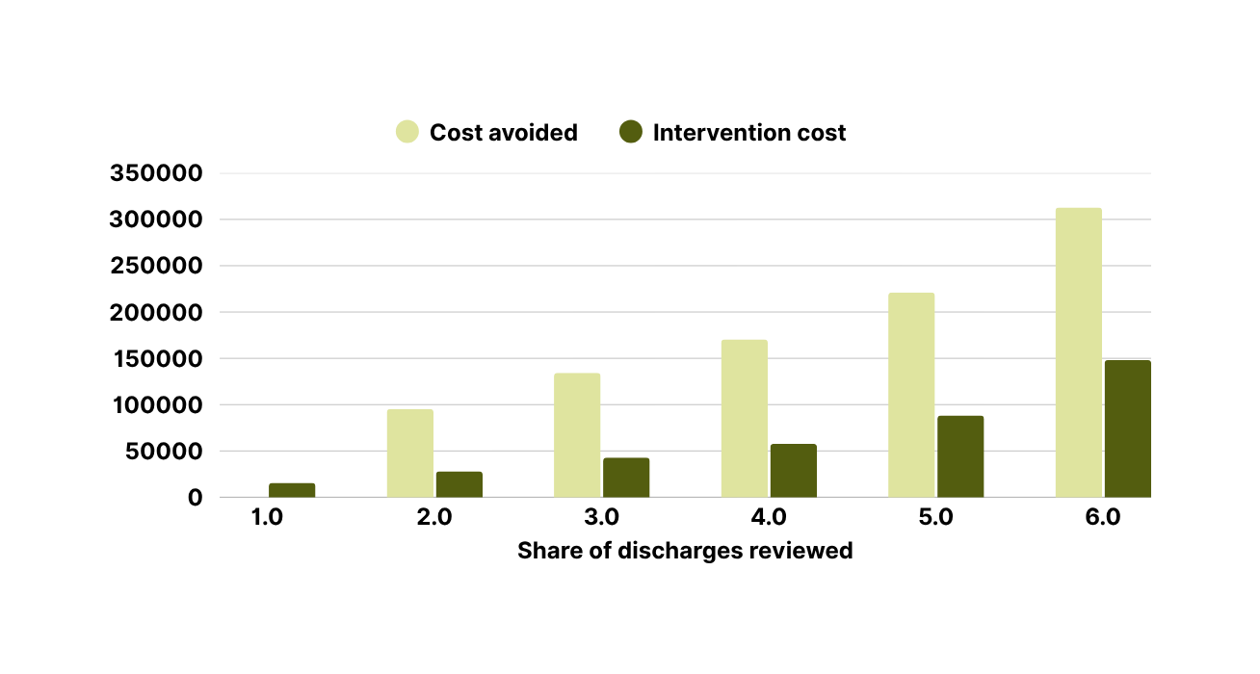
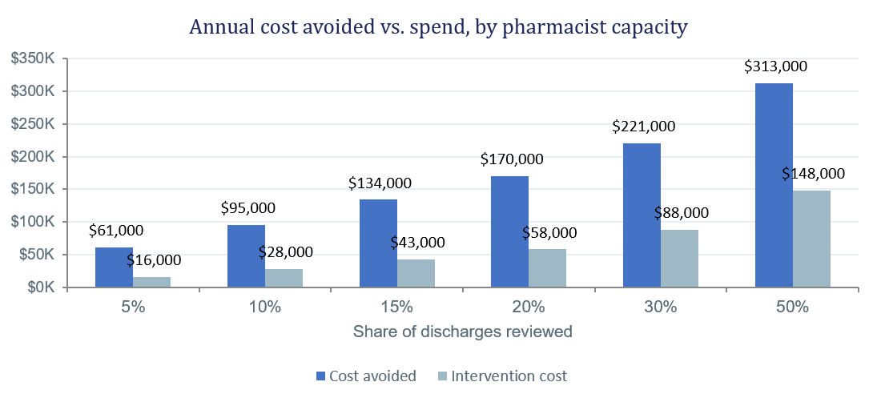
COST, VALUE & BUSINESS IMPACT
Under stated assumptions — $10,000 per avoided readmission, $60 per pharmacist intervention, 10-point risk reduction, 5,000 discharges/year.
AT 20% CAPACITY
$112,666
estimated annual net value · 3.0× ROI
961 patients flagged · 17 readmissions prevented
ROI FALLS AS CAPACITY RISES
3.9× at 5% capacity → 2.1× at 50%. Total net value keeps climbing, but each additional pharmacist hour buys less.
$10K is a conservative assumptions, not hospital-reported figures. The 10-point risk reduction is drawn from medication-reconciliation literature and was not measured here — net value scales almost linearly with it, which is why the dashboard exposes it as a slider.
Current source: AHRQ HCUP Statistical Brief #278
In 2018 there were 3.8 million 30-day all-cause adult hospital readmissions, with a 14 percent readmission rate and an average readmission cost of $15,200.
Notes:
What's it worth? Assumptions on screen: ten thousand per avoided readmission, sixty dollars per intervention, a ten-point risk reduction.
(point to the big number)
At 20% capacity: about $113,000 in annual net value at a 3× return.
(point to the chart)
But the useful story is the shape. Net value climbs as you review more — but ROI falls. 3.9× at 5%, down to 2.1× at 50%. So where you stop is a staffing decision, and leadership can move that slider themselves.
(point to the amber box — do not skip)
And plainly: these are stated assumptions, not hospital figures. The one most likely to be wrong is that ten-point reduction — it's from the literature. We did not measure it. Net value scales almost linearly with it, which is why it's a slider, not a constant.

Slide 12


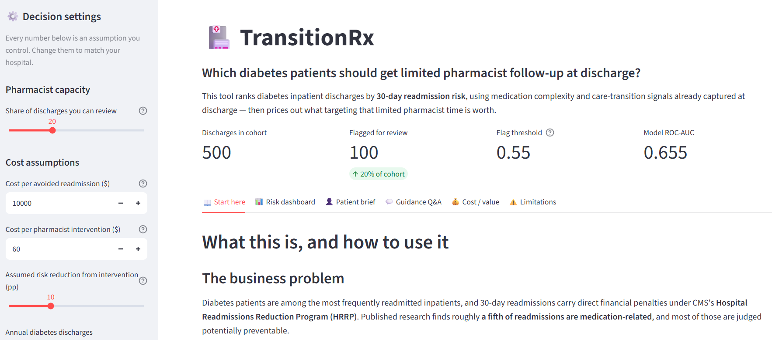


HUGGING FACE APP

Slide 13
BUSINESS RECOMMENDATION
Recommendation
~4
patients per working day
3.0×
estimated ROI
STAND UP A 90-DAY PHARMACIST PILOT ON THE TOP 15–20% OF DIABETES DISCHARGES
Why not 5%? Higher ROI but only 14% of readmissions caught. Why not 50%? ROI falls to 2.1× and requires 2.5× the pharmacist hours.
Phased path to adoption
Phase 1 · Days 0–90
Phase 2 · Days 90–180
Phase 3 · Day 180+
Pilot & measure
Audit & retrain
Scale to capacity
Run the worklist at 15–20%. Track readmissions in flagged-and-treated vs. flagged-and-untreated patients to track intervention data.
Complete the subgroup fairness audit. Retrain on recent local encounters — the published model is 1999–2008 and will not match our case mix.
Re-run the cost model with measured effect size, then set capacity where marginal ROI meets our staffing budget — not where the model suggests.
Notes:
So what do we actually recommend?
(point to the recommendation band)
A 90-day pharmacist pilot on the top 15 to 20% of diabetes discharges — about four patients per working day. Deliberately small.
We catch 30 to 38% of readmissions at roughly a 3× return, with no new headcount.
(walk the three phases)
Phase 1 — pilot and measure. Track flagged patients who got the intervention against those who didn't. That's the only way to learn the real effect size — the number our value case rests on.
Phase 2 — audit and retrain. Fairness audit, then retrain on recent local data.
Phase 3 — scale using a measured effect size.
(point to the ask)
The ask is narrow: Pharmacy and Care Management sponsor the pilot and agree up front on how we measure the effect.
Closing — 15 seconds
We can't predict readmissions well — nobody can from this data. But we don't need to. We need to rank well enough that limited pharmacist time goes to the right patients, and we roughly double the hit rate.
The model ranks. The RAG says what to do. A pharmacist decides.
Happy to take questions.

Slide 14
LIMITATIONS & APPROPRIATE USE
This tool -although very useful -ranks patients for a workflow decision. It does not diagnose, does not recommend treatment, and must not be used to deny or restrict care.
WHAT THE MODEL CAN'T SEE
DATA IS OUTDATED
FAIRNESS NOT YET AUDITED
No vitals, lab trends, social determinants, medication adherence, or discharge-summary text — all known readmission drivers.
Training data is 1999–2008. Coding practice, diabetes pharmacotherapy, and discharge workflows have all changed since.
Subgroup performance across race, age, sex, and payer has not been evaluated. Required before any real deployment.
THE ASSUMPTION MOST LIKELY TO BE WRONG
The model predicts readmission risk. The value case assumes intervention reduces that risk. Responsiveness to pharmacist follow-up is assumed from literature, not measured.
Notes:
I'll close on limitations rather than a summary.
This tool ranks patients for a workflow decision. It does not diagnose, does not recommend treatment, and must not be used to deny care.
(walk the three cards quickly)
It can't see vitals, labs, social determinants, or adherence — all known readmission drivers. The data is 1999 to 2008, so practice has moved on. And fairness has not been audited — the most important gap, because a model that allocates a benefit can entrench disparities.
(point to the amber box — strongest point in the deck)
Then the conceptual one. The model predicts readmission risk. Our value case assumes intervention reduces it. Those are different claims. A patient can be genuinely high-risk and still not benefit.
That gap is the strongest argument for piloting before scaling.

Slide 15
THANK YOU

